Slide 1
SMOKE: Single-Stage Monocular 3D Object Detection via Keypoint Estimation
Lulu Liu
3D Detection
09/14/2021

Slide 2
Background
Estimating 3D orientation and translation of objects
Depend on LiDAR point cloud
expensive, have a short service life time and too heavy for autonomous robots
attach an additional network branch
introduces persistent noise from 2D detection

Slide 3
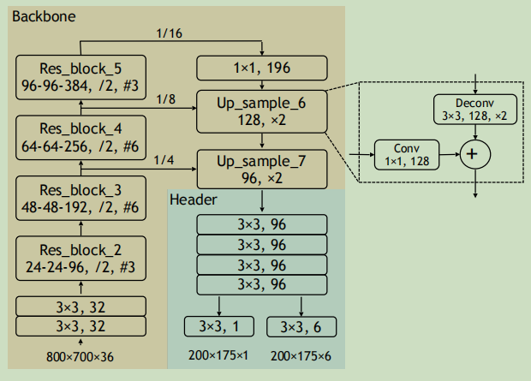
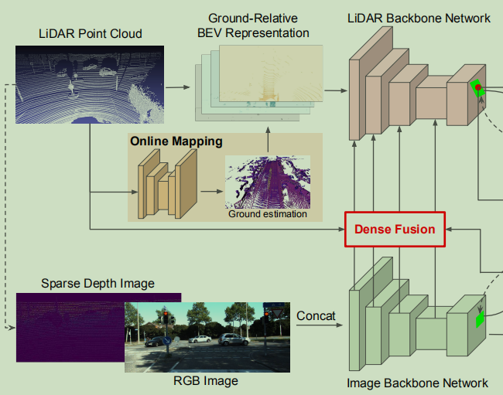
Related Work
LiDAR/Fusion based methods
Figure 1. The network architecture of PIXOR.
Figure 2. The first stage of the architecture of the proposed multi-task multi-sensor fusion model for 2D and 3D object detection.
Notes:
The backbone network is used to extract general representation of the input in the form of convolutional feature maps. The header network is a multi-task network that handles both object recognition and localization.
The model is a simplified two-stage detector with densely fused two-stream multi-sensor backbone networks. Online ground estimation eases 3D object localization as traffic participants of interest all lay on the ground.

Slide 4
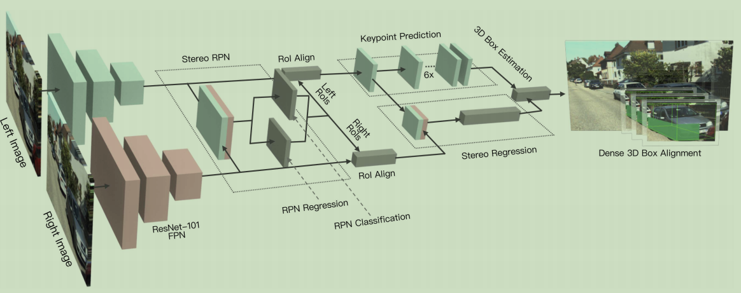
Related Work
Stereo images based methods
Figure 3. Network architecture of the proposed Stereo R-CNN .
Notes:
Network architecture of the proposed Stereo R-CNN (Sect. 3) which outputs stereo boxes, keypoints, dimensions, and the viewpoint angle, followed by the 3D box estimation (Sect. 4) and the dense 3D box alignment module。

Slide 5
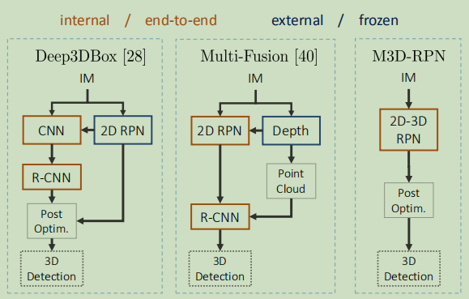
Related Work
Monocular image based methods
Figure 4. Comparison of Deep3DBox and Multi-Fusion with M3D-RPN.
Notes:
uses an external SOTA object detector to generate 2D proposals then processes the cropped proposals within a deep neural network to estimate 3D dimensions and orientation;
utilize an additional network to predict a depth map which is subsequently used to estimate a LiDAR-like point cloud;
to generate 2D and 3D object proposals simultaneously;
Consequently, none of the above methods can estimate 3D information accurately without generating 2D proposals, with a simple single stage.

Slide 6
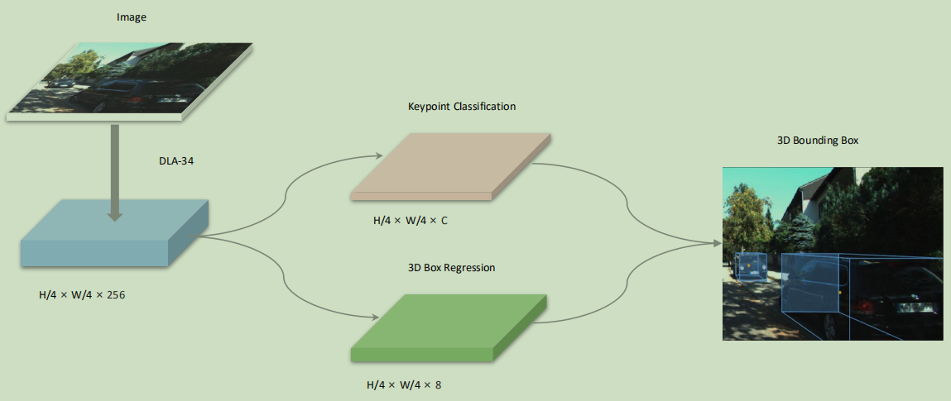
Approach —— Backbone
Figure 5. The first part of the Network Structure of SMOKE.
Notes:
use a hierarchical layer fusion network DLA-34 as the backbone to extract features since it can aggregate information across different layers.

Slide 7
Approach —— 3D Detection Network
Figure 6. The second part of the Network Structure of SMOKE.
Notes:
Instead of identifying the center of a 2D bounding box, the key point is defined as the projected 3D center of the object on the image plane.
regression head predicts the essential variables to construct 3D bounding box for each keypoint on the heatmap.
the 3D information is encoded as an 8-tuple τ = _x0002_δz δxc δyc δh δ w δ l sin α cos α。

Slide 8



Approach —— Loss Function
Keypoint Classification Loss
Regression Loss
final loss
Notes:
Let si,j be the predicted score at the heatmap location (i, j) and yi,j be the ground-truth value of each point assigned by Gaussian Kernel.
The term (1 - yi,j ) corresponds to penalty reduction for points around the groundtruth location.
λ is used to ensure that neither the classification, nor the regression dominates the other.
The multi-step disentangling trans formation divides the contribution of each parameter group to the final loss.

Slide 9
Implementation
Preprocessing
Data Augmentation
Hyperparameter Choice
Training Parameters
KITTI dataset
Notes:
we only eliminate objects whose 3D projected center point on the image plane is out of the image range.
Data augmentation techniques we used are random horizontal flip, random scale and shift.

Slide 10
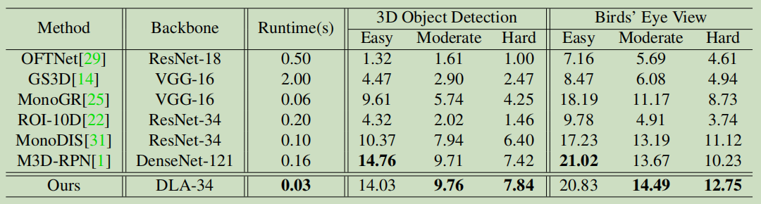
Performance Evaluation
Table 1. Test set performance. 3D object detection and Birds'eye view performance w.r.t. the car class on the official KITTI dataset using the test split. Both metrics are evaluated by AP|_{R40} at 0.7 IoU threshold.

Slide 11
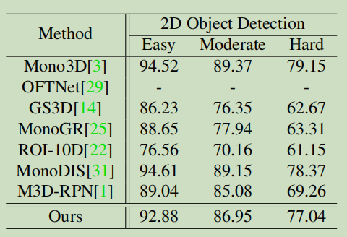
Performance Evaluation
Table 2. 2D detection. AP|_{R40} performance w.r.t. the car class on the official KITTI data set using the test split.
Notes:
This clearly shows that 3D object detection provides more abundant information than 2D detection, hence 2D proposals are redundant and not needed for 3D detection.
The 2D detection box is obtained as the smallest rectangle that encircles the projected 3D bounding box on the image plane.

Slide 12
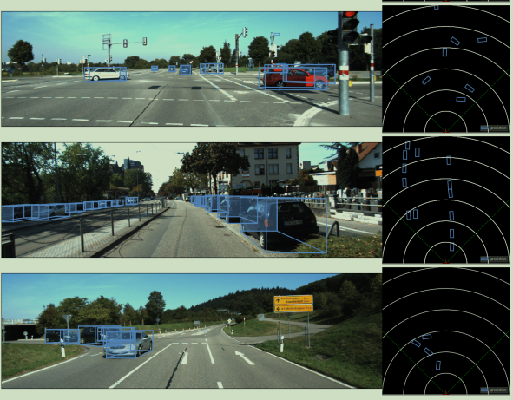
Performance Evaluation
Figure 7. Qualitative examples from the test sets in KITTI. The non-transparent side of the bounding box represents the front part of each car. Bird’s eye view is also provided to show that SMOKE can recover object distances accurately.

Slide 13
Conclusion
presented a novel single-stage monocular 3D object detection method
largely improve both the detection accuracy and speed

Slide 14
References
[1] Yang B, Luo W, Urtasun R. Pixor: Real-time 3d object detection from point clouds[C]//Proceedings of the IEEE conference on Computer Vision and Pattern Recognition. 2018: 7652-7660.
[2] Liang M, Yang B, Chen Y, et al. Multi-task multi-sensor fusion for 3d object detection[C]//Proceedings of the IEEE/CVF Conference on Computer Vision and Pattern Recognition. 2019: 7345-7353.
[3] Brazil G, Liu X. M3d-rpn: Monocular 3d region proposal network for object detection[C]//Proceedings of the IEEE/CVF International Conference on Computer Vision. 2019: 9287-9296.
[4] Liu Z, Wu Z, Tóth R. Smoke: Single-stage monocular 3d object detection via keypoint estimation[C]//Proceedings of the IEEE/CVF Conference on Computer Vision and Pattern Recognition Workshops. 2020: 996-997.

